Slide 1
Forms/Methods of Presentation - II
Classroom Presentation & Individual Conferencing

Slide 2
Unit 3 – Technical Presentation: Strategies & Techniques
Modes of Presentation – 4 methods of presentation delivery.
Strategies of Presentation – Audience, Locale, AV Aids, Kinesics, Paralinguistics, etc.
Forms/Methods of Presentation –
Interpersonal Communication –Characteristics, Elements, Types (Verbal & Non-verbal)
Classroom Presentation – Method/Types, Style and Tips
Individual Conferencing – Basic Introduction
Public Speaking –
Pattern- Deductive, Inductive, Causal, Q&A, etc.
Methods- Modes of delivery
Effective Public Speaking Techniques- Tips to make public speaking interesting.
Audience Participation and how to grasp audience interest
Use of humor, emotion, quizzes and interjection
Handling/Overcoming Stage Fear - Tips
Topics ‘A’ and ‘B’ to be studied from First Year notes.
Topics ‘C’, and ‘D’ to be studied from Second Year textbook and class notes.

Slide 3
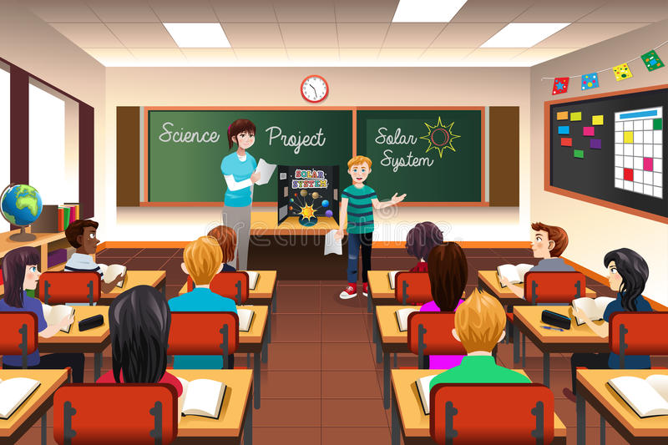
Classroom Presentation

Slide 4
Introduction
An important means to share information.
Builds confidence.
Inculcates basic LSRW skills.
Make students eloquent and alert

Slide 5
Planning
Know your audience
Specify objectives, benefits, and rationale
Identify key points, subpoints, and supporting detail
Organize presentation in logical order

Slide 6
Rehearsal
Use keywords!
Mentally run through presentation
Practice in similar surroundings
Practice answering questions
Feedback

Slide 7
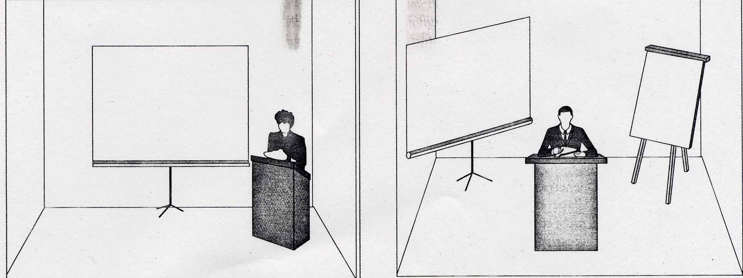
Setting Up
Check equipment ahead of time
Slides and projection screen should be placed in center of room.
Overhead screen and/or flip chart should be placed in the corners of the room at 45 degree angles.

Slide 8
Delivery
Stand up while presenting.
Face the audience, stand straight, hands OUT of pockets, and arms at your side.
Do NOT speak with your back to the audience.
Move while speaking.
Preferably use extemporaneous method.

Slide 9
Voice
Use natural conversation voice
Do NOT read presentation
Vocal variety (no monotone)
Speak slowly and comfortably
Speak loud enough for everyone to hear you

Slide 10
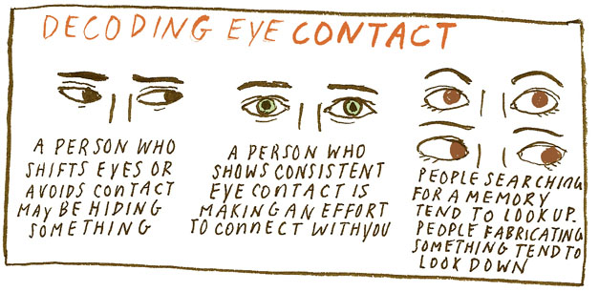
Eye Contact
Speak only when you have eye contact with the audience
Looking them in the eye is a great way to keep their attention.

Slide 11

Visuals
Visuals help keep the learners’ attention.
Visuals are a good source of reinforcement.
After using visuals, turn off computer, overhead, etc. so attention gets back to you.

Slide 12
Important Tips for Students
Prepare cue cards; Do not read from notes.
Use visual aids.
Speak with clarity.
Appropriately use both verbal and non-verbal mode.
Appropriate use of all attributes of Kinesics, Proxemics, Chronemics & Paralinguistics.

Slide 13
Types
Individual Presentation –
Single presenter.
Group Presentation –
Multiple presenter.
Maintaining coherence is important.
Ideally, every member should speak for equal amount of time.

Slide 14

Individual Conferencing

Slide 15
Introduction
A critical tool of supervision.
Facilitates interaction, sharing and feedback in a systematic, planned and confidential setting.
Provides a platform to discuss issues and concerns.
Provides the individual an opportunity to reflect on strengths and weaknesses and work on them for the betterment.
When someone is doing individual conferencing he/ she is working on skills that need to be reinforced or skills that will provide enrichment.

Slide 16
Essentials/Requirements
Should be conducted in privacy.
The person who conducts the individual conference should have a positive attitude.
Should be conducted from time to time according to the need of the hour.

Slide 17

Advantages
Provide individualized instruction.
Helps in investigating knowledge level.
Provide reinforcement and/or enrichment of skills.
Positive impact upon the individual.

Slide 18
THANKS

